Slide 1
MRL CRG – Cleanaway Update
29 November 2018

Slide 2
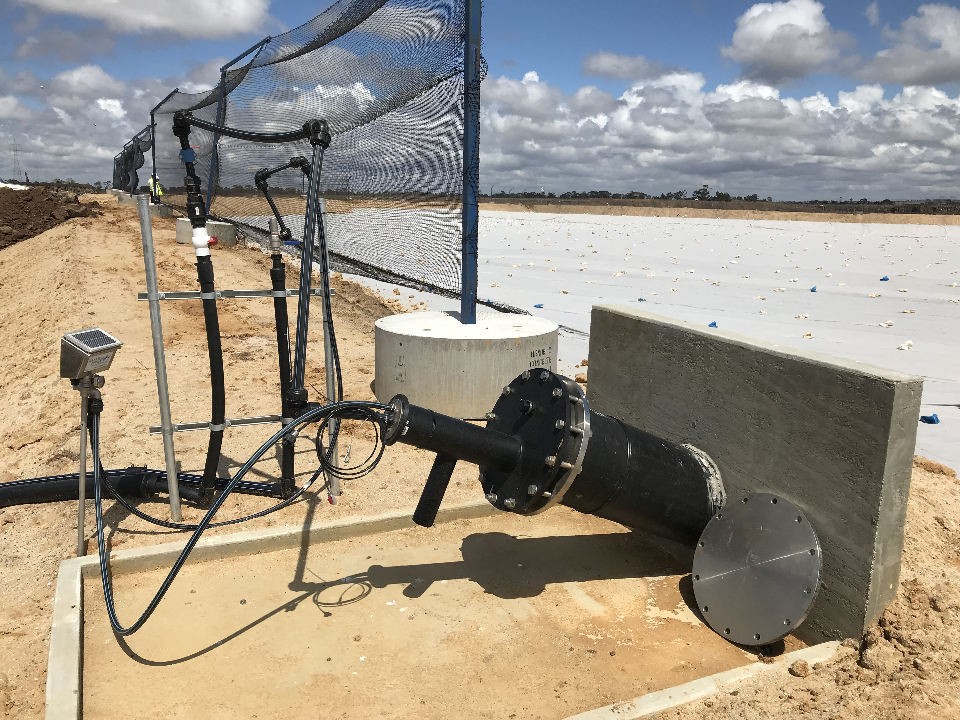
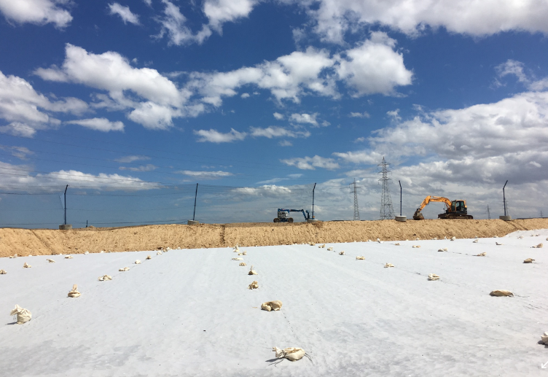
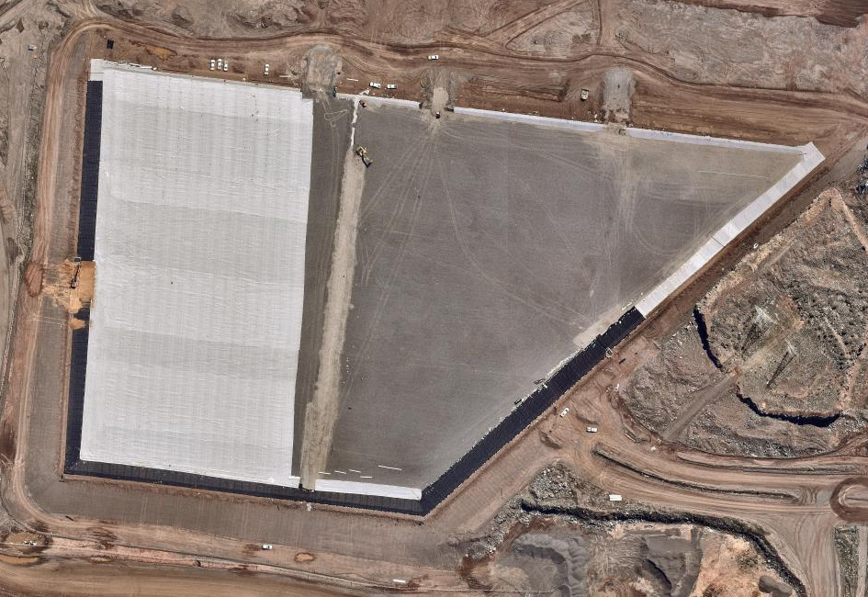
Cell Construction
Cell 4A construction completed and added to the license.
Key environmental improvements:
Litter management
Re-design of leachate sumps
Sub grade works have commenced for Cell 4B-1

Slide 3
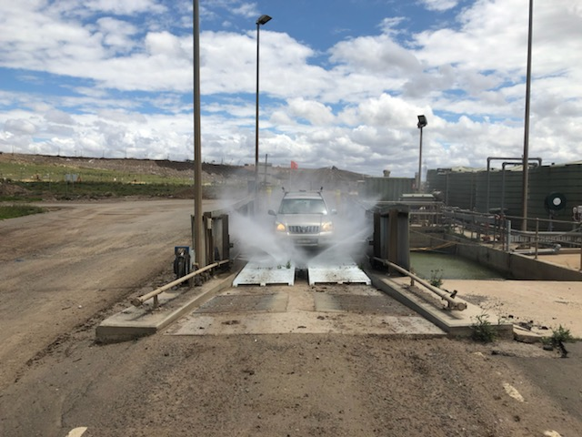
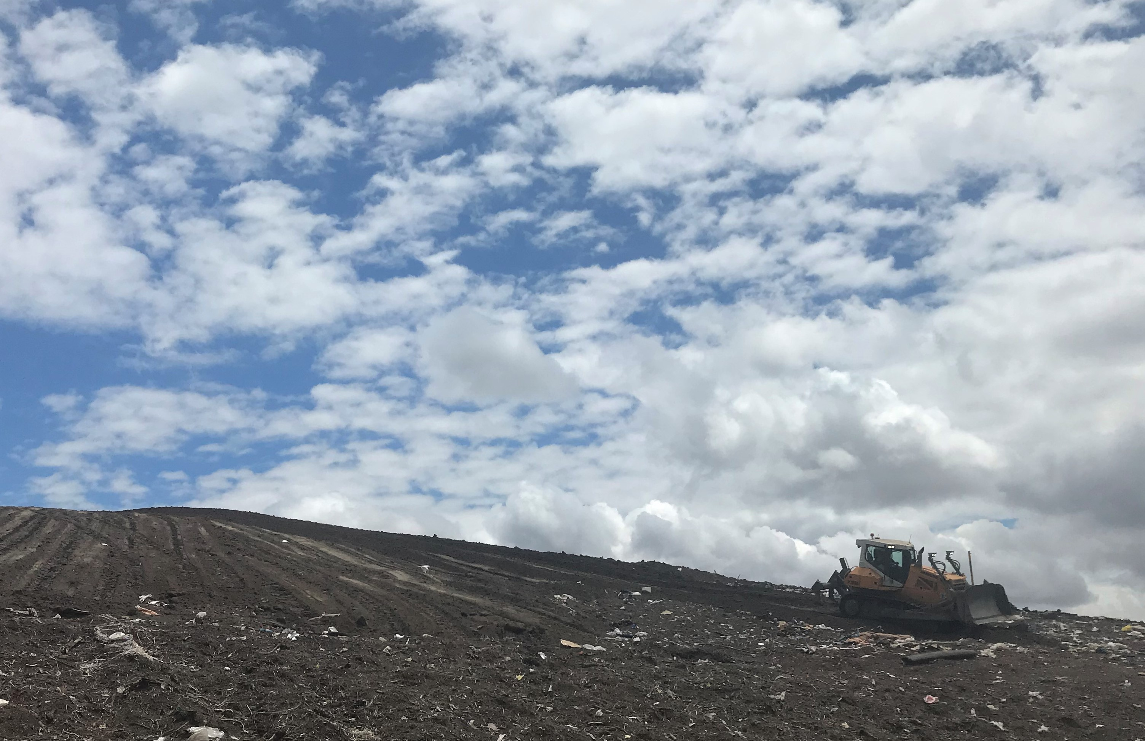
Operations Update
Screening soil bunds left by Boral
Will begin transition into Cell 4A late this week / early next week.
New haul constructed.
Have begun placing intermediate capping on Cell 3B.

Slide 4
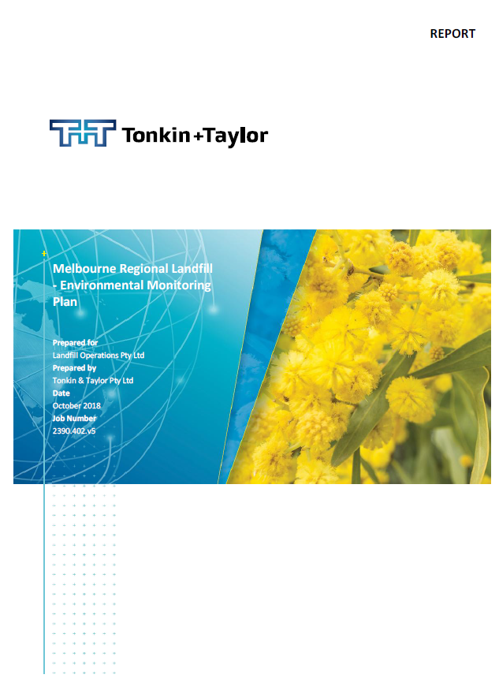
Environment Update
November groundwater monitoring event completed.
Update to the Landfill Operations Risk Assessment & Landfill Environmental Monitoring Plan. Conditional auditor approval.
Environmental Audit commenced.
New set of horizontals being installed in Cell 3B
Wheel wash repairs completed.
Surface emission monitoring underway.

Slide 5
Major Projects Update
Major works scheduled in the next 12 months
12 m Litter Nets: Geotechincal works commencing once suitable permits have been issues for drilling (approval required from Department of Mining). Current expected completion July 2019.
LFG Upgrades: Design of new LFG ring main going out to tender in December 2019. Construction design for new vertical extraction wells in Cell 2M also going out to tender early in 2019.
Leachate Sumps: Will go to tender January 2019 for the development of Leachate Riser Construction Quality Assurance Plan and subsequent construction of new leachate risers.

