Slide 1
MRL CRG – Cleanaway Update
Thursday 6 September 2018

Slide 2
Site Operations – General Update
Cell 4A: Liner, aggregate and cushioning being placed. Completion date is late December.
Cell 4B: Design currently being reviewed by the EPA.
Cell 3B: Airspace until early 2019.
Nick Stuhlener resigned. Advertising for new operations manager.
Meldina Klehic is the new Regional Manager

Slide 3
Environmental Compliance – Litter
Litter escape 10 August 2018
Cleanaway response:
Litter picking crews mobilised over the weekend
Repaired damaged fences and added additional litter controls into the cell
Purchasing 12 new portable panels (approx. $180K)
Purchasing 2 km of 6 m litter fencing (approx. $420K)
Upgrading the 12 m litter fencing (approx. $1.5 million)

Slide 4
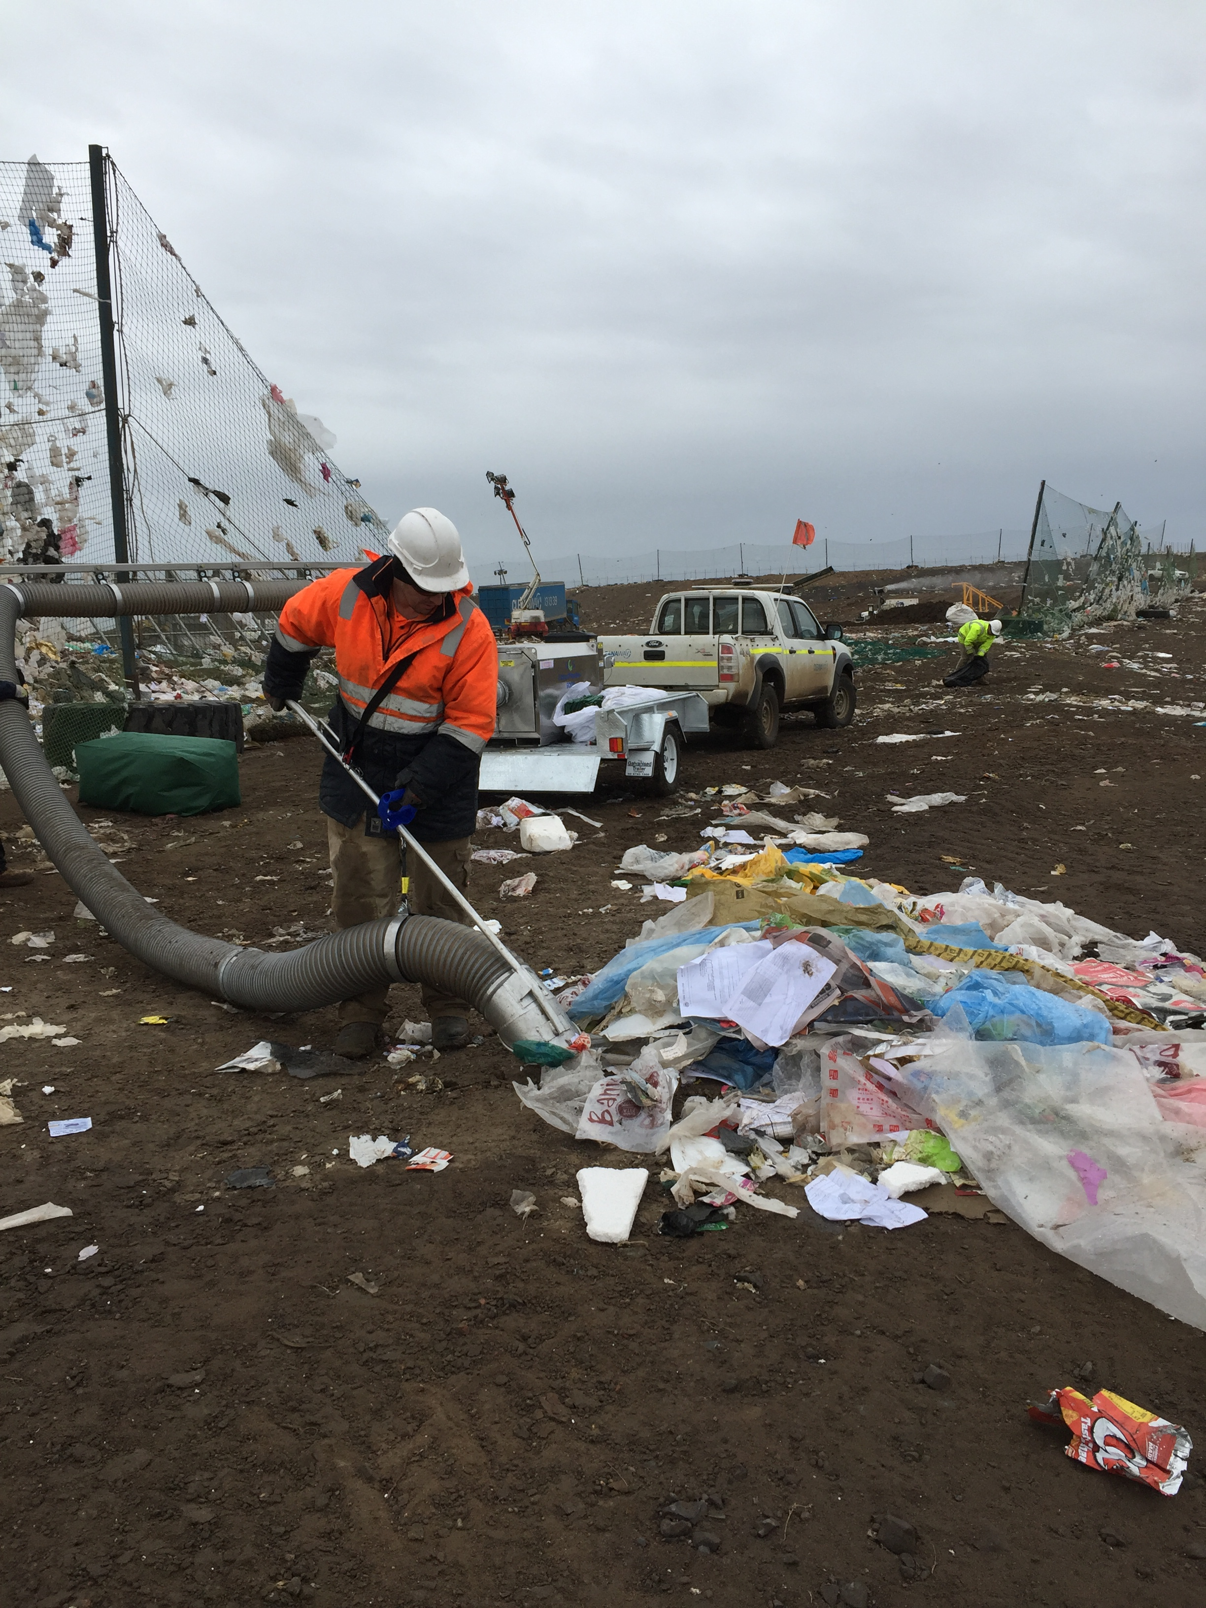
Environmental Compliance – Other
Leachate: Began rectification works this week.
LFG: Continuous monitoring until installed in GM12
LEMP / LORA: Update due mid-October.
Audit: Anthony Lane (SLR) engaged as auditor.
Odour: No verified complaints

Slide 5
Question From Previous Meeting: Category C Contaminated Soil
Best practice for contaminated land: National Environment Protection Council (1999) National Environment Protection (Assessment of Site Contamination) Measure, as amended (registered on 15 May 2013)(NEPC 2013).
The following table assumes that the criteria HIL D (Commercial / Industrial) is the most relevant criteria to apply to a landfill.
 | IWRG – Cat C (mg/kg) | NEPM – HIL D (mg/kg) |  | IWRG – Cat C (mg/kg) | NEPM – HIL D (mg/kg)
Arsenic | 500 | 400,000 | Lead | 1,500 | 1,500
Cadmium | 100 | 900 | Mercury | 75 | 730
Chromium (VI) | 500 | 3,600 | Molybdenum | 1,000 | 21,000
Copper | 5,000 | 240,000 | Nickel | 3,000 | 6,000
Tin | 500 | 1,300 | Selenium | 50 | 10,000
Silver | 180 | 24,000 | Zinc | 35,000 | 400,000
Cyanide | 2,500 | 1,500 | Fluoride | 10,000 | 170,000
Phenols (halogenated) | 10 | 660 | Phenols (non-halogenated) | 560 | 25,000
MAH | 70 | 430 | Benzene | 4 | 430
PAH | 100 | 4,000 | B(a)P | 5 | 16.5
C6 – C9 TRH | 650 | 26,000 | C10 – C36 TRH | 10,000 | 20,000
PCBs | 2 | 7 | Hexachlorobutadine | 2.8 | 100
Vinyl Chloride | 1.2 | 17 | Chlorinated Hydrocarbons | 10 | 17
Aldrin + Dieldrin | 1.2 | 45 | DDT + DDD + DDE | 50 | 3,600
Chlordane | 4 | 530 | Heptachlor | 1.2 | 50
OCPs | 10 | 50

